Slide 1
Colour Theories & Some Applications
“The purest and most thoughtful minds are those which love color the most.”
— John Ruskin

Slide 2
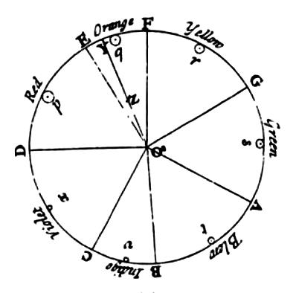
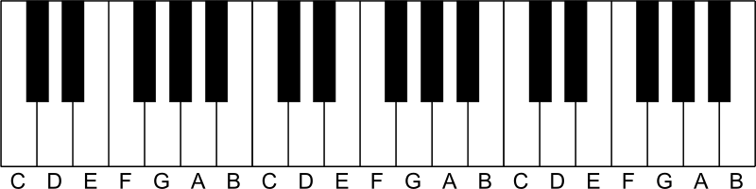
Scientific & Philosophical Interests & Origins of Modern Colour Theory
Isaac Newton Opticks 1704 (old spelling of Optics)
  Used musical scale to divide spectrum and attach names to areas
  Physics (but theological implications)

Slide 3
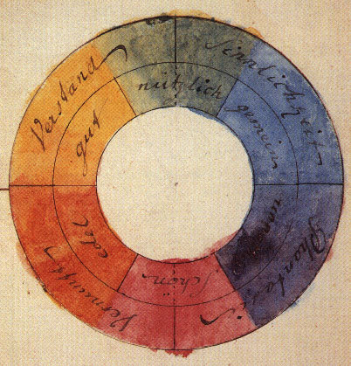
Interpretations of Colour Theory by artists
Goethe’s Theory of Colours (1810)
Built on wavelength theory of light (after Newton)
Methods interesting
Conclusion refuted
Influential on artists
Ex. Turner
Colour theory weblink
Goethe’s Colour Wheel

Slide 4

optical effects of adjacent tonal values or colours link to stroboscopic effects (complementary colors seen as grey) http://www.michaelbach.de/ot/mot_strob/index.html

Slide 5
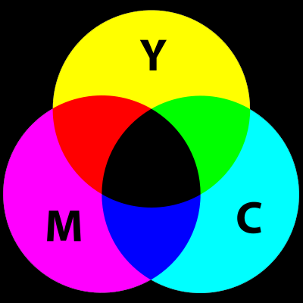
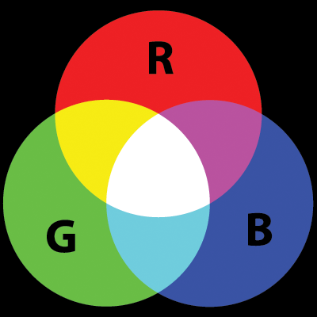
Types of Colour Theories
Subtractive Theory
  The subtractive, or pigment theory deals with how white light is absorbed and reflected off of coloured surfaces.
Additive Theory
  The Additive, or light theory deals with radiated and filtered light.

Slide 6
Subtractive Theory
Black absorbs most light
White reflects most light
Coloured Pigments absorb light and reflect only the frequency of the pigment colour.
All colours other than the pigment colours are absorbed so this is called subtractive colour theory.
The primary colours in Subtractive Theory are:
  Cyan ( C )
  Magenta ( M )
  Yellow ( Y )
  Black ( K )
Subtractive or Pigment Theory is used in printing and painting.

Slide 7
Additive Theory
Black radiates no light
White (sun) radiates all light
Video is the process of capturing and radiating light, therefore it uses Additive (Light) Theory not Subtractive (Pigment) Theory.
The primary colours in Additive Theory are:
  Red ( R )
  Green ( G )
  Blue ( B )
The primary colours add together to make white
Light Theory is also called Additive Theory.
Light Theory is used in Television, theater lighting, computer monitors, and video production.

Slide 8
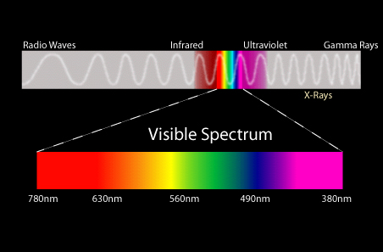
The Visible Spectrum

Slide 9

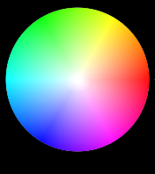

The Colour Wheel
If the ends of the spectrum are bent around a colour wheel is formed:

Slide 10
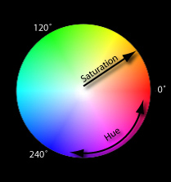

The Colour Wheel
Colours on the wheel can be described using three parameters:
Hue: degrees from 0˚ to 360˚
Saturation: brightness or dullness
Value: lightness or darkness
(As suggested by Henry Albert Munsell in A Colour Notation, 1905)

Slide 11
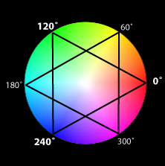
The Colour Wheel: Hue
Hue or Spectral Colour is represented as an angle.
Primary Colours:
  0˚ = Red
  120˚ = Green
  240˚ = Blue
Secondary Colours:
  60˚ = Yellow
  180˚ = Cyan
  300˚ = Magenta

Slide 12
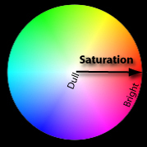
The Colour Wheel: Saturation
Saturation or Chroma is the intensity of a colour.
A highly saturated colour is bright and appears closer to the edge of the wheel.
A more unsaturated colour is dull.
A colour with no saturation is achromatic or in the grey scale.

Slide 13
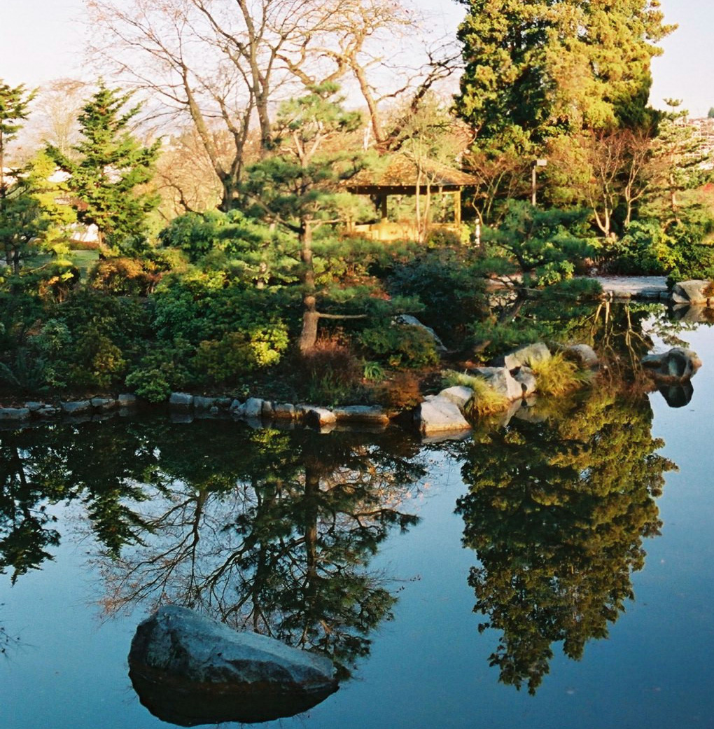
The Colour Wheel: Value
"the quality by which we distinguish a light colour from a dark one."
Albert Henry Munsell
A Colour Notation 1905
Value represents the luminescent contrast value between black and white

Slide 14
The Colour Wheel: Value

Slide 15
The Colour Wheel: Value

Slide 16
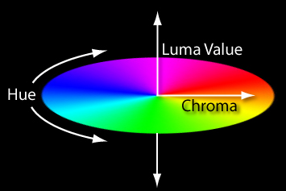
The Colour Wheel 3d
Three parameters to describe a colour: Hue Chroma Value

Slide 17
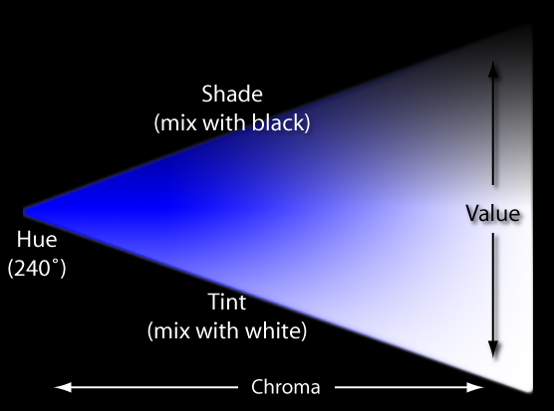
Tone = Shade + Tint

Slide 18
Using Color--
blue in large regions, not thin lines
red and green in the center of the
field of view (edges of retina not sensitive to these)
black, white, yellow in periphery
Color Brewer
Pantone

Slide 19
Colour Schemes
Systematic ways of selecting colours
Monochromatic
Complimentary
Analogous
Warm
Cool
Achromatic
Chromatic Grays

Slide 20
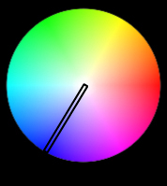
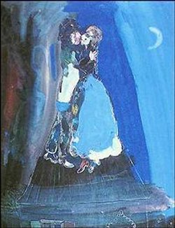
Colour Schemes: Monochromatic
Monochromatic:
One Hue many values of Tint and Shade
Artist: Marc Chagall
Title: Les Amants Sur Le Toit

Slide 21
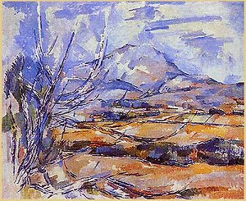
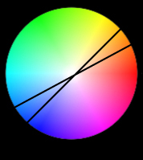
Colour Schemes: Complementary (note spelling--NOT complimentary)
Complimentary: Colours that are opposite on the wheel. High Contrast
Artist: Paul Cezanne
Title: La Montage Saint Victoire
Year: 1886-88

Slide 22
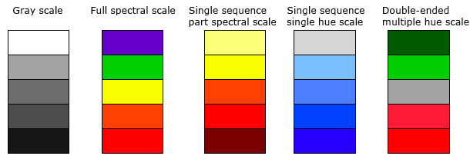
Color for Categories and Sequences

Slide 23
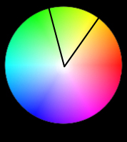
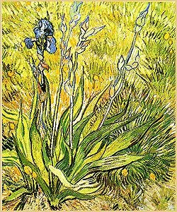
Colour Schemes: Analogous
Artist: Vincent van Gogh
Title: The Iris
Year: 1889
Analogous: A selection of colours that are adjacent. Minimal contrast

Slide 24
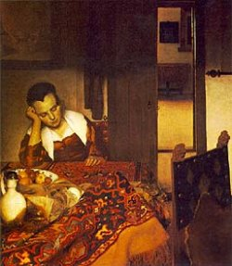
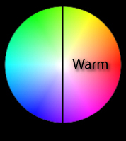
Colour Schemes: Warm
Artist: Jan Vermeer
Title: Girl Asleep at a Table
Year: 1657
Warm: First half of the wheel give warmer colours. The colours of fire.

Slide 25
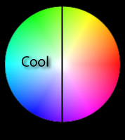
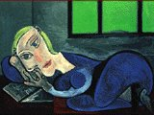
Colour Schemes: Cool
Artist: Pablo Picasso
Title: Femme Allongée Lisant
Year: 1939
Cool: Second half of the wheel gives cooler colours

Slide 26
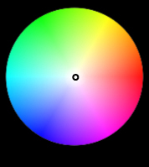
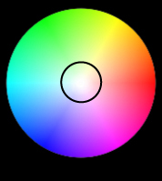
Colour Schemes:
Achromatic, Chromatic Grays
Achromatic: Black and white with all the grays in-between.
Chromatic Grays: Also called neutral relief. Dull colours, low contrast.

Slide 27
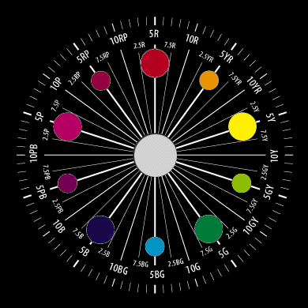
Colour Pickers & Choice of Media
HSB, HLS, HSV
RGB
CMYK
Others
  Lab
  PANTONE
Munsell’s notation wheel

Slide 28
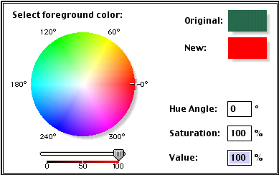
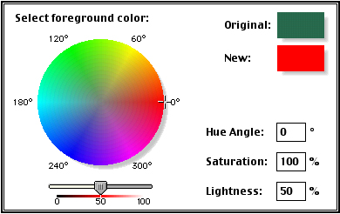
Colour Pickers: HSB, HLS, HSV
HSV
    Hue
    Saturation
    Value
HSB (Same as HSV)
    Hue
    Saturation
    Brightness
HLS
    Hue
    Lightness
    Saturation

Slide 29
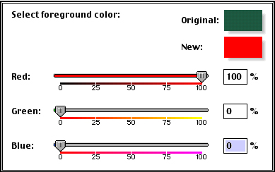
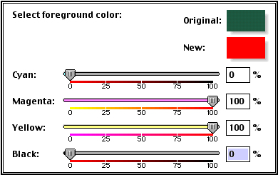
Colour Pickers: RGB, CMYK
RGB
    Red
    Green
    Blue
  Used in Video and Computer graphics
  3 Values in % or between
    0-255
CMYK
    Cyan
    Magenta
    Yellow
    K = Black
  Used for printing

Slide 30
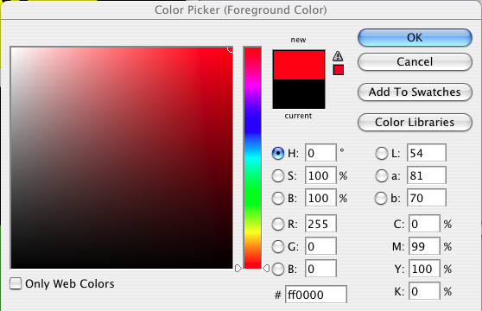
Photoshop CS3 Picker
Combines
HSB,
RGB,
CMYK,
Lab
(Luminance, Red/Green, Yellow/Blue)
Adobe
http://kuler.adobe.com/

Slide 31
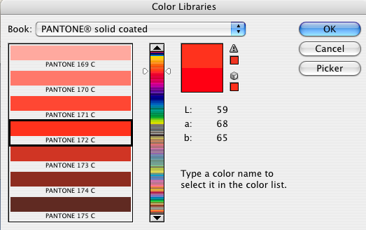
Colour Pickers: PANTONE
Standard for printing/fastion industry

Slide 32
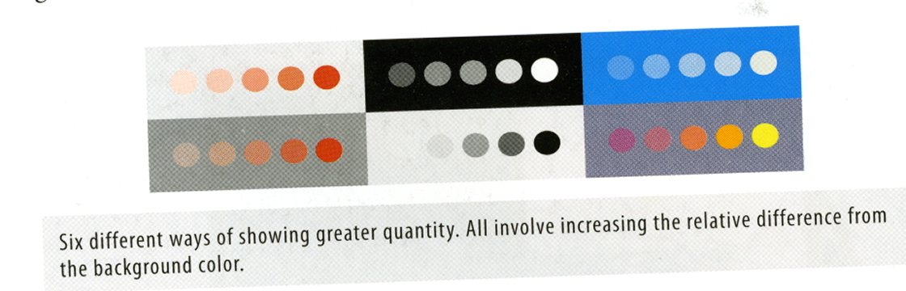
Color and the visual display of information
Ware, p. 84

